Slide 1
Lecture # 1
Microprocessor Based Systems

Slide 2
Topics to Cover:
  Computer & Microprocessor
  Evolution of Intel Microprocessors
  (Main Influence on 8086/8088 µP)
  Involvement of IBM PC
  Semi-conductor Technology
  Evolution of Digital Computers
  Reprogrammable & Embedded µP
  Difference b/w µP and µC

Slide 3
Computer & Microprocessor
  Computer:
    A Computer is a programmable machine.
    The two principal characteristics of a computer are:
    i) It responds to a specific set of instructions in a
    well defined manner.
    ii) It can execute a prerecorded list of instructions (a
    program).
    Modern computers are electronic and digital .
    The actual machinery wires, transistors, and circuits
    is called hardware. the instructions and data are
    called software.

Slide 4
Computer & Microprocessor
  Microprocessor:
    A silicon chip that contains a CPU. In the world of
    personal computers, the terms microprocessor and
    CPU are used interchangeably.
    A microprocessor (sometimes abbreviated µP) is a
    digital electronic component with miniaturized
    transistors on a single semiconductor integrated
    circuit (IC).
    One or more microprocessors typically serve as a
    central processing unit (CPU) in a computer system
    or handheld device.
    Microprocessors made possible the advent of the
    microcomputer.

Slide 5
Computer & Microprocessor
  Microprocessor:
    At the heart of all personal computers and most
    working stations sits a microprocessor.
    Microprocessors also control the logic of almost all
    digital devices, from clock radios to fuel-injection
    systems for automobiles.
    Three basic characteristics differentiate
    microprocessors:
    i) Instruction set: The set of instructions that the
    microprocessor can execute.
    ii) Bus width : The number of bits processed in a
    single instruction.

Slide 6
Computer & Microprocessor
  Microprocessor:
    Clock speed : Given in megahertz (MHz), the clock
    Speed determines how many instructions per second
    the processor can execute.
    In both cases, the higher the value, the more
    powerful the CPU. For example, a 32 bit
    microprocessor that runs at 50MHz is more powerful
    than a 16-bit microprocessor that runs at 50MHz.
    In addition to bus width and clock speed,
    microprocessors are classified as being either RISC
    (reduced instruction set computer) or CISC (complex
    instruction set computer).

Slide 7
Evolution of Intel Microprocessors
  Microprocessor 4004:
    Date: Intel introduced its first Microprocessor in
    1971.
    4-Bit Microprocessor i.e. 4-Bit Central Processing Unit.
    Clock Speed: 108 KHz.
    Int. register width: 8 bit.
    Bus width: 4 bits.
    No. of Transistors: 2300.
    Min. feature size: 10 micron.
    Main memory size: 640 Bytes.

Slide 8
Evolution of Intel Microprocessors
  Microprocessor 8008, 8080 & 8085:
    Date: In 1974 second generation microprocessor
    was introduced.
    These devices were 8-bit microprocessors. They can
    talk in terms of 8-bits and they have answers for
    8-bit data manipulation, data logics & calculations.
    Main memory size: 64K Bytes.

Slide 9
Evolution of Intel Microprocessors
  Microprocessor 8086:
    Date: In 1978, Intel introduced the 16-bit
    Microprocessor 8086.
    This processor is a major improvement over the
    previous Microprocessor 8080/8085`s series.
    i) First the Memory Capacity has been enhanced to
    1 Megabyte (MB).
    ii) Data larger than 8-bits has not to be broken into
    blocks of 8-bits because it can handle upto 16 bits.

Slide 10
Evolution of Intel Microprocessors
  Microprocessor 8086:
    Pipelining Architecture: In a system with pipelining,
    the data and address buses are busy in transferring
    the information while the processor is processing the
    information.
    Although pipelining is a common feature in mini and
    main-frame computers, Intel was a pioneer in
    putting this pipelining feature on a single
    microprocessor.

Slide 11
Evolution of Intel Microprocessors
  Evolution from 8086 to 8088:
    As 8086 is a 16-bit microprocessor so it has 16-bit
    Data Bus internally & externally i.e. there is a
    16-bit data bus to transfer data in & out to the
    CPU and it has 16-bit internal registers.
    Although 8086 microprocessor is a great achievement
    but still there was some resistance in using the 16
    bit external data bus since at that time all peripherals
    were designed around an 8-bit microprocessor. In
    addition, the Printed Circuit Board with a 16-bit data
    bus was much more expensive.
    Intel came out with 8088 version. Which is identical
    to 8086 in terms of features but with 8-bit External
    Data Bus.

Slide 12
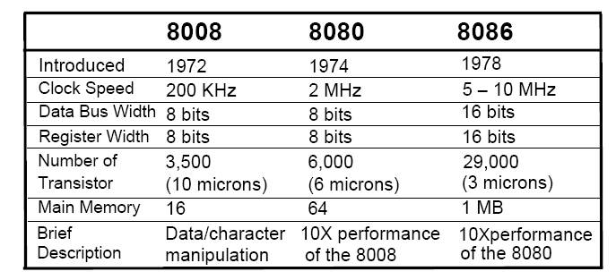
Evolution of Intel Microprocessors

Slide 13
Involvement of IBM PC
    In 1981, Intel`s fortunes changed forever when IBM
    picked up the 8088 as their microprocessor of choice in
    designing the IBM PC.
    The 8088-based IBM PC was an enormous success, largely
    because IBM and Microsoft (the developer of the MS-DOS
    operating system) made it an open system, meaning that
    all documentation and specifications of the hardware and
    software of the PC were made public. This made it
    possible for many other vendors to clone the hardware
    successfully and thus sparked a major growth in both
    hardware & software designs based on the IBM PC.
    This is in contrast with the Apple computer, which was a
    closed system, blocking any attempt at cloning by other
    manufacturers.

Slide 14
Evolution of Intel Microprocessors
  Other Microprocessor 80286, 80386, 80486:
    As 80286 introduced in 1982.
    16–bit internal and external data buses.
    24 Address lines meaning that it can take 16MB.
    Real Mode/Protected Mode: Real Mode is simply a
    exactly faster like 8086/8088 with the same
    maximum of 1 Megabyte of memory. Protected mode
    allows for 16M of memory but is also capable of
    protecting the operating system and programs from
    accidental or deliberate destruction by a user, a
    feature that missed in 8086/8088.

Slide 15
Evolution of Intel Microprocessors
  Other Microprocessor 80286, 80386, 80486:
    Virtual Memory arrived, It is the way of fooling the
    microprocessor into thinking that it has access to an
    almost unlimited amount of memory by swapping
    data between disk storage and memory.

Slide 16
What is going behind the curtains: How Microprocessor become so much powerful
  Semiconductor Technology:
    Transistor Density: The evolution of microprocessors
    were made possible by advances in semiconductor
    process technology. Concepts like VLSI, MSI & SSI.
    Semiconductor-device geometry means the transistor
    density. Transistor density decreased from about 5
    microns in the early 1970s to submicron today.

Slide 17
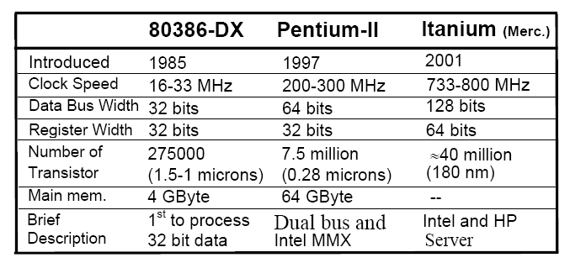
Proof of Transistor Density:

Slide 18
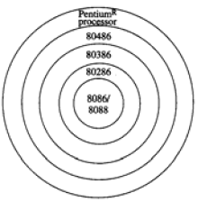

Slide 19
Moore`s Law

Slide 20
Moore`s Law Perdiction

Slide 21
Performance of Microprocessors
  MIPS:
  The performance of microprocessors are expressed in terms
  of its Bandwidth (number of bits processed in a single
  instruction), Instruction set (set of instructions that can be
  executed) and Clock-speed (number of executed-instructions
  per second) (Note that, bench marks are called MIPS (million
  instructions per second) and iCOMP index etc.)

Slide 23
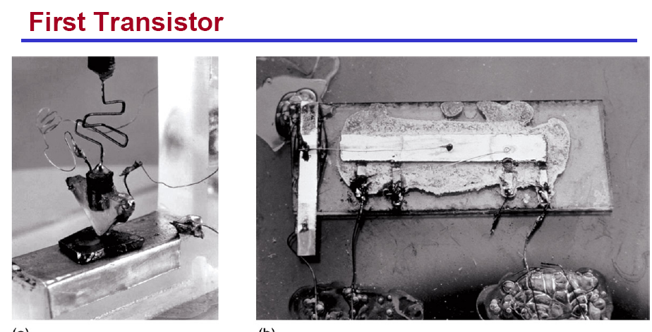
Previous History of Transistors

Slide 24
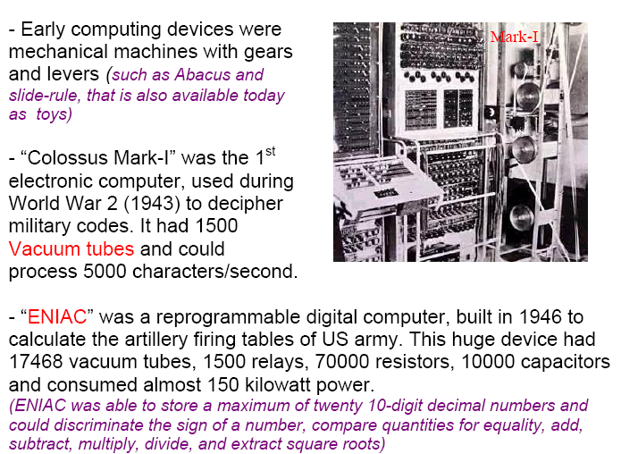
Evolution of Digital Computers

Slide 25
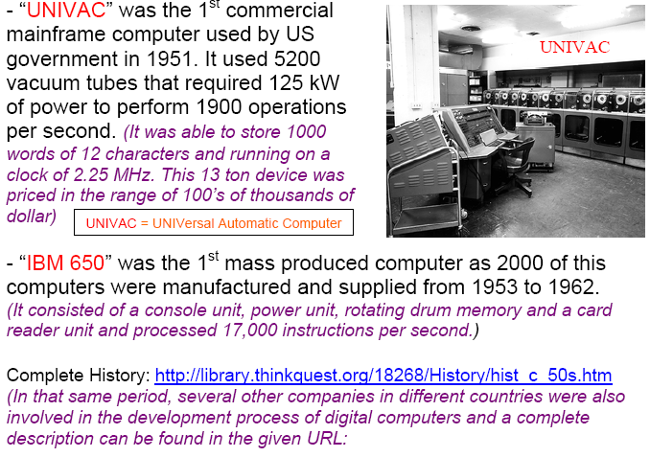
Evolution of Digital Computers

Slide 26
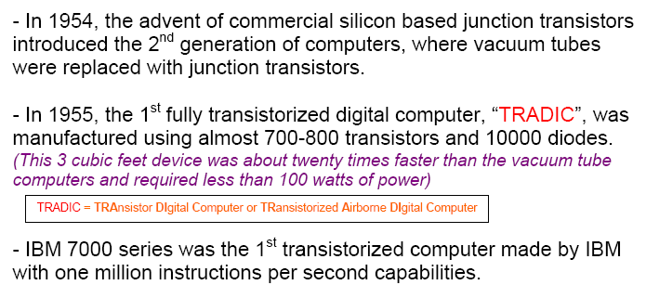
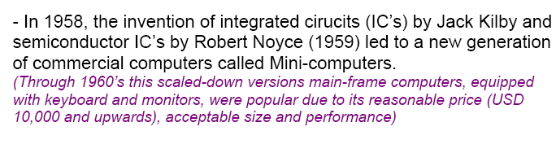
Evolution of Digital Computers

Slide 27
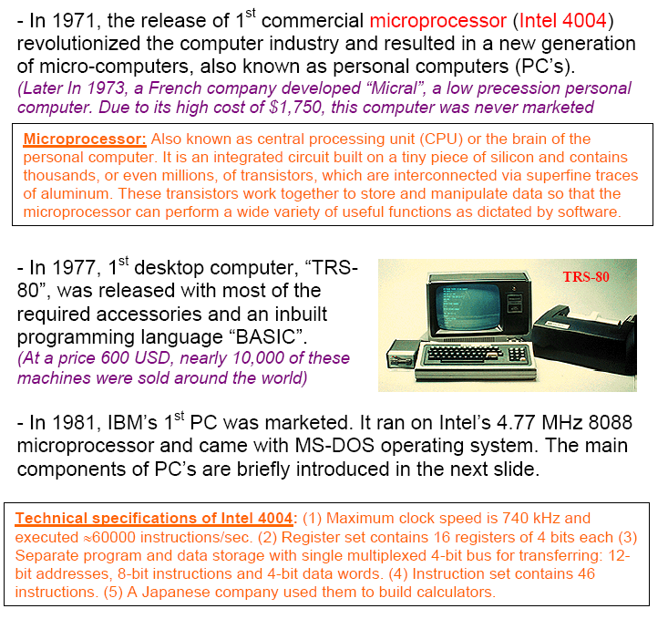
Evolution of Digital Computers

Slide 28
Reprogrammable & Embedded Microprocessors
    Microprocessors can be classified according to the type of
    application for which they have been designed. \
    Two application oriented categories:
    1) Reprogrammable Microprocessors
    2) Embedded Microprocessors & Microcontrollers.
    1) Reprogrammable Microprocessor are used for
    general applications.
    2) Embedded µP and µC are used to perform a
    dedicated control function.
    Dedicated Control Function may be: Event Control like
    Industrial Process Control, Data Control like Hard Disk
    Controller Interface.

Slide 29
Reprogrammable & Embedded Microprocessors
    Reprogrammable means that a general purpose
    microcomputer can be used to run a variety of software
    applications i.e. while it is in use, it can be easily
    reprogrammed to run a different application. While, you
    cannot do this in embedded microcomputers.

Slide 30
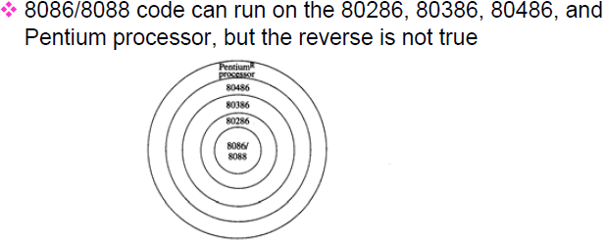
Reprogrammable & Embedded Microprocessors

Slide 31
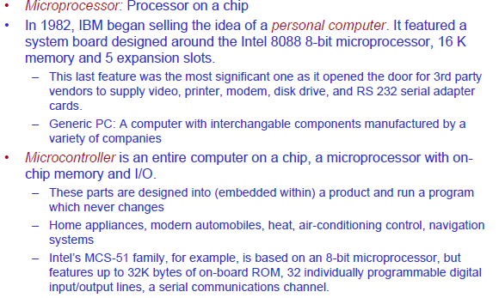
Microprocessors vs Microcontrollers

Slide 32
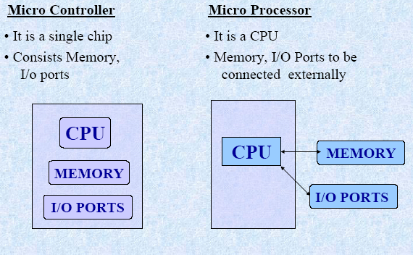
Microprocessors vs Microcontrollers
Specific Purpose Based
General Purpose Based

Slide 33
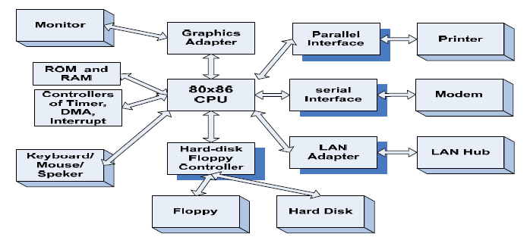
Microprocessors vs Microcontrollers

Slide 34
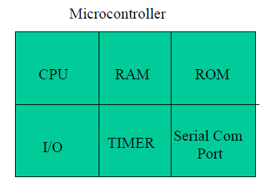
Microprocessors vs Microcontrollers

Slide 35
CHAPTER # 2
Software Architecture of the 8088 & 8086 µP

Slide 36
Learning Objective:
  To perform any operation from 8086
  or 8088 Microprocessors, we have to
  program it with Assembly Language.
  In this lecture we explore Microprocessor
  from Software Point of View. And in the
  process we learn how the microprocessor,
  and its memory and input/ouput sub-
  syetms operates.

Slide 37
Topics to Cover: (Ch-2)
  Software Model of 8088/8086 µP
  Segment Registers and Memory Segmentation
  Instruction Pointer
  Pointer Register
  Index Registers
  Data Registers
  Status Register
  Generating a Memory Address
  The Stack
  Input/Output Address Space

Slide 38
Software Model of 8088/8086 µP
  In order to program µP, one have
  to consider the processor view
  as shown in fig:
    Remember our aim is to understand
    the microprocessor operation from
    a software point of view.
    One does not have to know the
    function of various pins, electrical
    signals, electrical connections or their
    electrical switching characteristics.
    The function, interconnection and
    operation of the internal circuits of
    microprocessors may not need to
    consider at this stage.

Slide 39
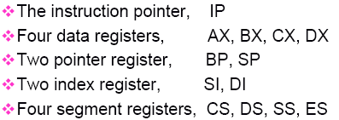
Software Model of 8088/8086 µP
    Internally, it contains Registers. All
    the abbreviations in the figure are
    actually the name of registers.
    Each Register is of 16-bit as
    8086/8088 is of 16-bit.
    No of Registers: 13 + SR = 14
  Registers names are:

Slide 40
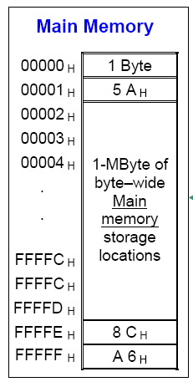
Software Model of 8088/8086 µP

Slide 41
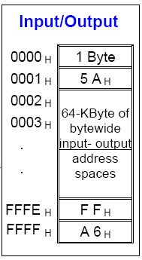
Software Model of 8088/8086 µP
  Input/Output Address Space:

Slide 42
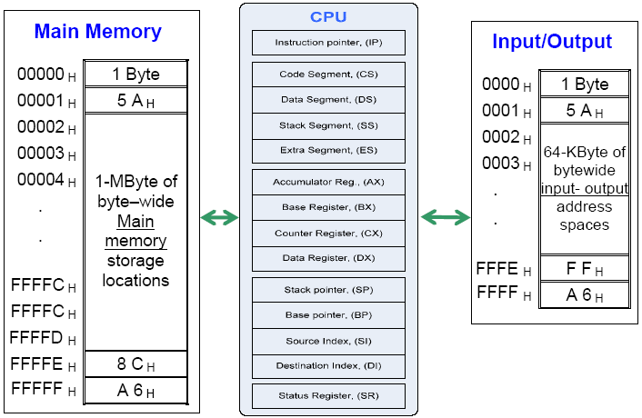
Software Model of 8088/8086 µP

Slide 43
Topics to Cover: (Ch-2)
  Software Model of 8088/8086 µP
  Segment Registers and Memory Segmentation
  Instruction Pointer
  Pointer Register
  Index Registers
  Data Registers
  Status Register
  Generating a Memory Address
  The Stack
  Input/Output Address Space

Slide 44
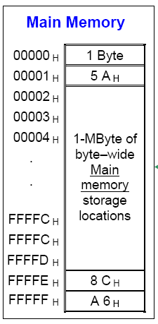
Segment Registers and
Memory Segmentation
  Memory Segmentation:
    Although 8086/8088 µP can access
    up to 1MByte of Memory. Not all
    this memory is active at a time
    due to lack of resources.
    Actually, 1 MByte of memory is
    partitioned into 64K Segments.
    Why??
    For the time being, remember
    each register is of 16-bit, so one
    can get maximum value of 2^16=
    65536 = 64K.
    Only four of these 64K segments
    are active at a time.

Slide 45
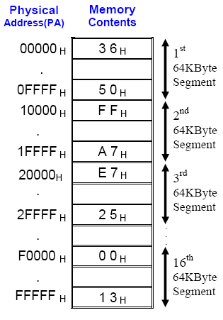
Segment Registers and
Memory Segmentation
  Memory Segmentation:
    Partitioned into 64K Segments.
    Only 4 Segments out of all
    64K Segment will be active.
  Why??
  Answer is:
  Segment Registers:
    Four Segment Register:
    CS, DS, SS, ES

Slide 46
Segment Registers and
Memory Segmentation
  Code Segment:
  Stores Instructions i.e. Codes
  Data Segment:
  Stores Program Data.
  Stack Segment:
  Stores Temporary Information like Push, Pop, Jump, Call etc.
  Extra Segment:
  Also for Data Storage.
  Actually, code stores in the memory.
  Code Segment Register contains the Base Address i.e. Starting Address on which the instructions started to enter.
  Actually, data stores in the memory.
  Data Segment Register contains the Base Address i.e. Starting Address on which the data started to enter.

Slide 47
Segment Registers and
Memory Segmentation

Slide 48
Dedicated, Reserved And
General Use Memory
The Area from FFFFCH to FFFFFH is reserved pointer area for future products and should not be used.

Slide 49
Dedicated, Reserved And
General Use Memory

Slide 50
Topics to Cover: (Ch-2)
  Software Model of 8088/8086 µP
  Segment Registers and Memory Segmentation
  Instruction Pointer
  Pointer Register
  Index Registers
  Data Registers
  Status Register
  Generating a Memory Address
  The Stack
  Input/Output Address Space

Slide 51
Instruction Pointer

Slide 52
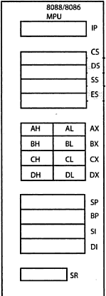
Code Segment : Instruction
Pointer
Code Segment : Instruction Pointer
16 Bit Address in Segment Registers
20 Bit Address Bus

Slide 53
Code Segment : Instruction
Pointer
Code Segment : Instruction Pointer
Offset Address
Physical
Address
Base Address
20 Bit Address Bus

Slide 54
Code Segment : Instruction
Pointer
CS: IP = 0000:0001
0001
0000
Base Address: 0000
Offset Address: 0001
B.Add: 0000(0)
Off. Add:+ 0001
Phy. Add:= 00001

Slide 55
Code Segment : Instruction
Pointer
Code Segment : Instruction Pointer
0003
0000
Base Address: 0000
Offset Address: 0001
B.Add: 0000(0)
Off. Add:+ 0003
Phy. Add:= 00003

Slide 56
Code Segment : Instruction
Pointer
CS:IP = 0000:FFFF
FFFF
0000
Base Address: 0000
Offset Address: 0001
B.Add: 0000(0)
Off. Add:+ FFFF
Phy. Add:= 0FFFF

Slide 57
Topics to Cover: (Ch-2)
  Software Model of 8088/8086 µP
  Segment Registers and Memory Segmentation
  Instruction Pointer
  Index Registers
  Pointer Register
  Data Registers
  Status Register
  Generating a Memory Address
  The Stack
  Input/Output Address Space

Slide 58
Index Registers
  Two Index Registers:
  1) Source Index Register
  2) Destination Index
  These two registers hold the offset addresses
  w.r.t Data/Extra Segments.
  DS(0):SI = 20 Bit Address
  B.A(0):Offs.A = P.A
  DS(0):DI = 20 Bit address

Slide 59
Index Registers (SI,DI)

Slide 60
Topics to Cover: (Ch-2)
  Software Model of 8088/8086 µP
  Segment Registers and Memory Segmentation
  Instruction Pointer
  Index Registers
  Pointer Register
  Data Registers
  Status Register
  Generating a Memory Address
  The Stack
  Input/Output Address Space

Slide 61
Pointer Registers
  Two Pointer Registers:
  1) Stack Pointer Registers
  2) Base Pointer Registers
  These two registers hold the offset addresses
  w.r.t Stack Segments.
  SS(0):SP = 20 Bit Address
  B.A(0):Offs.A = P.A
  SS(0):BP = 20 Bit address

Slide 62
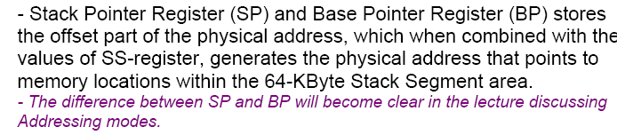
Pointer Registers (SP, BP)

Slide 63
Topics to Cover: (Ch-2)
  Software Model of 8088/8086 µP
  Segment Registers and Memory Segmentation
  Instruction Pointer
  Index Registers
  Pointer Register
  Data Registers
  Status Register
  Generating a Memory Address
  The Stack
  Input/Output Address Space

Slide 64
Data Registers
  These are also known as General Purpose Registers.
  Mainly used for Data Operation, Logics Calculation & Manipulation of Data.

Slide 65
Data Registers

Slide 66
Data Registers

Slide 67
Topics to Cover: (Ch-2)
  Software Model of 8088/8086 µP
  Segment Registers and Memory Segmentation
  Instruction Pointer
  Index Registers
  Pointer Register
  Data Registers
  Status Register
  Generating a Memory Address
  The Stack
  Input/Output Address Space

Slide 68
CHAPTER # 3
Software Architecture of the 8088 & 8086 µP

Slide 69
Learning Objective:
  To perform any operation from 8086
  or 8088 Microprocessors, we have to
  program it with Assembly Language.
  In this lecture we explore Microprocessor
  from Software Point of View. And in the
  process we learn how the microprocessor,
  and its memory and input/ouput sub-
  syetms operates.

Slide 70
Topics to Cover: (Ch-2)
  Software Model of 8088/8086 µP
  Segment Registers and Memory Segmentation
  Instruction Pointer
  Pointer Register
  Index Registers
  Data Registers
  Status Register
  Generating a Memory Address
  The Stack
  Input/Output Address Space

Slide 71
Software Model of 8088/8086 µP
  In order to program µP, one have
  to consider the processor view
  as shown in fig:
    Remember our aim is to understand
    the microprocessor operation from
    a software point of view.
    One does not have to know the
    function of various pins, electrical
    signals, electrical connections or their
    electrical switching characteristics.
    The function, interconnection and
    operation of the internal circuits of
    microprocessors may not need to
    consider at this stage.

Slide 72
Software Model of 8088/8086 µP
    Internally, it contains Registers. All
    the abbreviations in the figure are
    actually the name of registers.
    Each Register is of 16-bit as
    8086/8088 is of 16-bit.
    No of Registers: 13 + SR = 14
  Registers names are:

Slide 73
Software Model of 8088/8086 µP

Slide 74
Software Model of 8088/8086 µP
  Input/Output Address Space:

Slide 75
Software Model of 8088/8086 µP

Slide 76
Topics to Cover: (Ch-2)
  Software Model of 8088/8086 µP
  Segment Registers and Memory Segmentation
  Instruction Pointer
  Pointer Register
  Index Registers
  Data Registers
  Status Register
  Generating a Memory Address
  The Stack
  Input/Output Address Space

Slide 77
Segment Registers and
Memory Segmentation
  Memory Segmentation:
    Although 8086/8088 µP can access
    up to 1MByte of Memory. Not all
    this memory is active at a time
    due to lack of resources.
    Actually, 1 MByte of memory is
    partitioned into 64K Segments.
    Why??
    For the time being, remember
    each register is of 16-bit, so one
    can get maximum value of 2^16=
    65536 = 64K.
    Only four of these 64K segments
    are active at a time.

Slide 78
Segment Registers and
Memory Segmentation
  Memory Segmentation:
    Partitioned into 64K Segments.
    Only 4 Segments out of all
    64K Segment will be active.
  Why??
  Answer is:
  Segment Registers:
    Four Segment Register:
    CS, DS, SS, ES

Slide 79
Segment Registers and
Memory Segmentation
  Code Segment:
  Stores Instructions i.e. Codes
  Data Segment:
  Stores Program Data.
  Stack Segment:
  Stores Temporary Information like Push, Pop, Jump, Call etc.
  Extra Segment:
  Also for Data Storage.
  Actually, code stores in the memory.
  Code Segment Register contains the Base Address i.e. Starting Address on which the instructions started to enter.
  Actually, data stores in the memory.
  Data Segment Register contains the Base Address i.e. Starting Address on which the data started to enter.

Slide 80
Segment Registers and
Memory Segmentation

Slide 81
Dedicated, Reserved And
General Use Memory
The Area from FFFFCH to FFFFFH is reserved pointer area for future products and should not be used.

Slide 82
Dedicated, Reserved And
General Use Memory

Slide 83
Topics to Cover: (Ch-2)
  Software Model of 8088/8086 µP
  Segment Registers and Memory Segmentation
  Instruction Pointer
  Pointer Register
  Index Registers
  Data Registers
  Status Register
  Generating a Memory Address
  The Stack
  Input/Output Address Space

Slide 84
Instruction Pointer

Slide 85
Code Segment : Instruction
Pointer
Code Segment : Instruction Pointer
16 Bit Address in Segment Registers
20 Bit Address Bus

Slide 86
Code Segment : Instruction
Pointer
Code Segment : Instruction Pointer
Offset Address
Physical
Address
Base Address
20 Bit Address Bus

Slide 87
Code Segment : Instruction
Pointer
CS: IP = 0000:0001
0001
0000
Base Address: 0000
Offset Address: 0001
B.Add: 0000(0)
Off. Add:+ 0001
Phy. Add:= 00001

Slide 88
Code Segment : Instruction
Pointer
Code Segment : Instruction Pointer
0003
0000
Base Address: 0000
Offset Address: 0001
B.Add: 0000(0)
Off. Add:+ 0003
Phy. Add:= 00003

Slide 89
Code Segment : Instruction
Pointer
CS:IP = 0000:FFFF
FFFF
0000
Base Address: 0000
Offset Address: 0001
B.Add: 0000(0)
Off. Add:+ FFFF
Phy. Add:= 0FFFF

Slide 90
Topics to Cover: (Ch-2)
  Software Model of 8088/8086 µP
  Segment Registers and Memory Segmentation
  Instruction Pointer
  Index Registers
  Pointer Register
  Data Registers
  Status Register
  Generating a Memory Address
  The Stack
  Input/Output Address Space

Slide 91
Index Registers
  Two Index Registers:
  1) Source Index Register
  2) Destination Index
  These two registers hold the offset addresses
  w.r.t Data/Extra Segments.
  DS(0):SI = 20 Bit Address
  B.A(0):Offs.A = P.A
  DS(0):DI = 20 Bit address

Slide 92
Index Registers (SI,DI)

Slide 93
Topics to Cover: (Ch-2)
  Software Model of 8088/8086 µP
  Segment Registers and Memory Segmentation
  Instruction Pointer
  Index Registers
  Pointer Register
  Data Registers
  Status Register
  Generating a Memory Address
  The Stack
  Input/Output Address Space

Slide 94
Pointer Registers
  Two Pointer Registers:
  1) Stack Pointer Registers
  2) Base Pointer Registers
  These two registers hold the offset addresses
  w.r.t Stack Segments.
  SS(0):SP = 20 Bit Address
  B.A(0):Offs.A = P.A
  SS(0):BP = 20 Bit address

Slide 95
Pointer Registers (SP, BP)

Slide 96
Topics to Cover: (Ch-2)
  Software Model of 8088/8086 µP
  Segment Registers and Memory Segmentation
  Instruction Pointer
  Index Registers
  Pointer Register
  Data Registers
  Status Register
  Generating a Memory Address
  The Stack
  Input/Output Address Space

Slide 97
Data Registers
  These are also known as General Purpose Registers.
  Mainly used for Data Operation, Logics Calculation & Manipulation of Data.

Slide 98
Data Registers

Slide 99
Data Registers

Slide 100
Topics to Cover: (Ch-2)
  Software Model of 8088/8086 µP
  Segment Registers and Memory Segmentation
  Instruction Pointer
  Index Registers
  Pointer Register
  Data Registers
  Generating a Memory Address
  The Stack
  Status Register
  Input/Output Address Space

Slide 101
Generating a Physical memory Address
  Code Segment : Instruction Pointer
  Data Segment: Source/Destination Index
  Stack Segment: Stack/Base Pointer
  Extra Segment: Like Data Segment
  Four Data Registers are used for Data Calculation, Logics & Manipulation.
  Status Register to show the Status

Slide 102
Generating a Physical memory Address

Slide 103
Generating a Physical memory Address

Slide 104
Generating a Physical memory Address

Slide 105
Generating a Physical memory Address

Slide 106
Generating a Physical memory Address
  For summary, see once again on White Board.

Slide 107
Topics to Cover: (Ch-2)
  Software Model of 8088/8086 µP
  Segment Registers and Memory Segmentation
  Instruction Pointer
  Index Registers
  Pointer Register
  Data Registers
  Generating a Memory Address
  The Stack
  Status Register
  Input/Output Address Space

Slide 108
The Stack

Slide 109
The Stack

Slide 110
The Stack

Slide 111
The Stack

Slide 112
Topics to Cover: (Ch-2)
  Software Model of 8088/8086 µP
  Segment Registers and Memory Segmentation
  Instruction Pointer
  Index Registers
  Pointer Register
  Data Registers
  Generating a Memory Address
  The Stack
  Status Register
  Input/Output Address Space

Slide 113
CHAPTER # 4
Software Architecture of the 8088 & 8086 µP

Slide 114
Learning Objective:
  To perform any operation from 8086
  or 8088 Microprocessors, we have to
  program it with Assembly Language.
  In this lecture we explore Microprocessor
  from Software Point of View. And in the
  process we learn how the microprocessor,
  and its memory and input/ouput sub-
  syetms operates.

Slide 115
Topics to Cover: (Ch-2)
  Data Registers
  Status Register
  Generating a Memory Address
  The Stack
  Aligned & Misaligned Data
  Microarchitecture of 8086/8088
  Input/Output Address Space

Slide 116
Data Registers
  These are also known as General Purpose Registers.
  Mainly used for Data Operation, Logics Calculation & Manipulation of Data.

Slide 117
Data Registers

Slide 118
Data Registers

Slide 119
Topics to Cover: (Ch-2)
  Data Registers
  Generating a Memory Address
  The Stack
  Status Register
  Aligned & Misaligned Data
  Microarchitecture of 8086/8088
  Input/Output Address Space

Slide 120
Generating a Physical memory Address
  Code Segment : Instruction Pointer
  Data Segment: Source/Destination Index
  Stack Segment: Stack/Base Pointer
  Extra Segment: Like Data Segment
  Four Data Registers are used for Data Calculation, Logics & Manipulation.
  Status Register to show the Status

Slide 121
Generating a Physical memory Address

Slide 122
Generating a Physical memory Address

Slide 123
Generating a Physical memory Address

Slide 124
Generating a Physical memory Address

Slide 125
Generating a Physical memory Address
  For summary, see once again on White Board.

Slide 126
Topics to Cover: (Ch-2)
  Data Registers
  Generating a Memory Address
  The Stack
  Status Register
  Aligned & Misaligned Data
  Microarchitecture of 8086/8088
  Input/Output Address Space

Slide 127
The Stack
Stack grows in the direction of decreasing
addresses.
Stack is used to store WORDs only.
SP is initialized to FFFEH so that (SS:SP)
points to the bottom of stack (highest address
in the SS) in the beginning—empty stack
The Stack size = 64k bytes = 32k words
Stack segment reg (SS) contains end-of-stack
Stack BOTTOM is end-of-stack + (64k-1)
bytes.
(SS:SP) is last filled storage = TOS (Top of
Stack).

Slide 128
The Stack
Stack operation always involves either
reading a word (POP) or writing a word
(PUSH).
Single byte is never used
There are two operations which concern
STACK
1) PUSH OPERATION: Decrement SP by 2
and store the word then at SS:SP (least
significant byte at the lower address).
2) POP Operation: Read a word from (SS:SP)
and increment the SP by 2
STACK GROWS FROM HIGHER ADDRESSES
TO LOWER ADDRESSES

Slide 129
The Stack

Slide 130
The Stack

Slide 131
The Stack

Slide 132
The Stack

Slide 133
Topics to Cover: (Ch-2)
  Data Registers
  Generating a Memory Address
  The Stack
  Status Register
  Aligned & Misaligned Data
  Microarchitecture of 8086/8088
  Input/Output Address Space

Slide 134
Status Register

Slide 135
Status Register

Slide 136
Status Register

Slide 137
Status Register

Slide 138
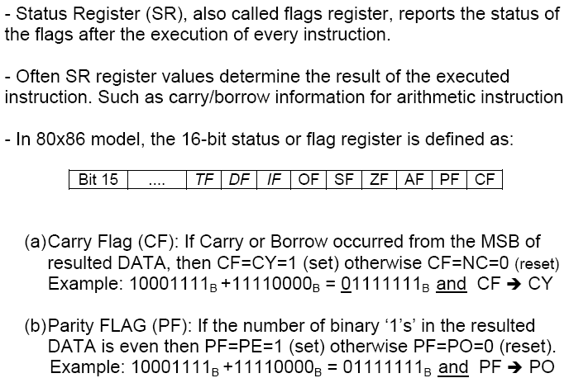
Status Register

Slide 139
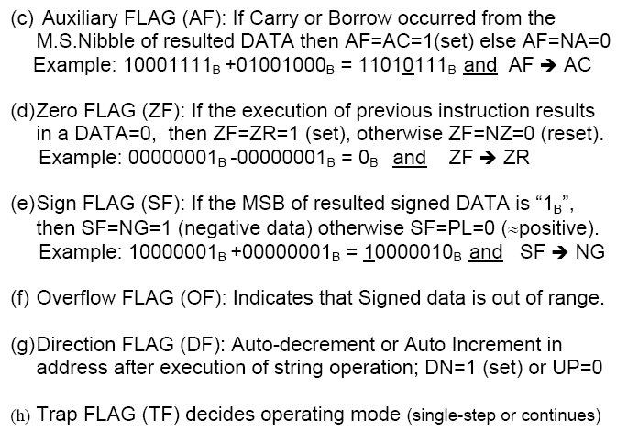
Status Register

Slide 140
Topics to Cover: (Ch-2)
  Data Registers
  Generating a Memory Address
  The Stack
  Status Register
  Aligned & Misaligned Data
  Microarchitecture of 8086/8088
  Input/Output Address Space

Slide 141
Memory Organization & Aligned & Misaligned Data

Slide 142
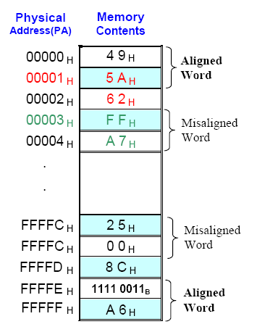
Memory Organization & Aligned & Misaligned Data
  To store a Word of 16-Bit, two consecutive Memory locations are required. Lower Byte would be stored in Lower Address of two consecutive bytes while higher byte would be stored in higher address of consecutive byte.
  Like to store data of 16-Bit i.e. 625A H
  5A = Lower Byte in 00001H 62 = Higher Byte in 00002H.

Slide 143
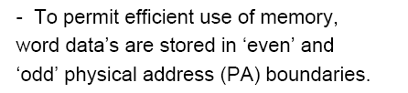


Memory Organization & Aligned & Misaligned Data

Slide 144
Memory Organization & Aligned & Misaligned Data
  Aligned Words are those which started with Address whose Least Significant Bit is ‘0’ also called Even Physical Address.
  Non-aligned Words are those which started with Address whose Least Significant Bit is ‘1’ also called Odd Physical Address.

Slide 145
Topics to Cover: (Ch-2)
  Data Registers
  Generating a Memory Address
  The Stack
  Status Register
  Aligned & Misaligned Data
  Microarchitecture of 8086/8088
  Input/Output Address Space

Slide 146
Microarchitecture of 8086/8088 Microprocessor

Slide 147
Microarchitecture of 8086/8088 Microprocessor
A computer is like a calculator with program stored in its memory (RAM).
When a program is being executed, the following cycle of operations is repeated;
1) Fetch the next instruction from the memory
2) Decode the instruction to find out what operation is
to be performed
3) Fetch the OPERAND(s) and store temporarily in the
internal register(s)
4) Execute the required operation and store the result
in memory or internal register as required by the
instruction.

Slide 148
Microarchitecture of 8086/8088 Microprocessor
Fetching of instructions is done by BUS INTERFACE UNIT (BIU)
Decoding, Fetching the operands and execution is done by the Execution Unit
These two units in 8088/86 family can work in parallel.
BIU fetches instruction bytes and stores them in internal registers which form a FIFO (First In First Out) queue. This is known as PRE-FETCHING of instruction.
8088 has a 4-byte FIFO, 8086 has 6-byte FIFO

Slide 149
Microarchitecture of 8086/8088 Microprocessor

Slide 150
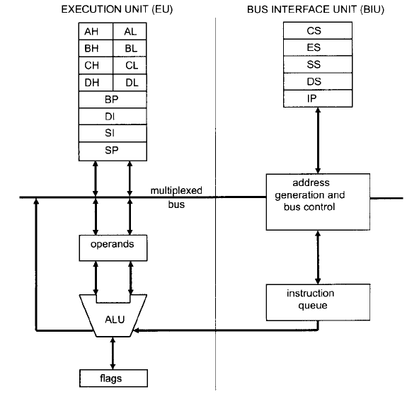
Microarchitecture of 8086/8088 Microprocessor

Slide 151
Microarchitecture of 8086/8088 Microprocessor
  Fetch & Execute Cycle

Slide 152
Microarchitecture of 8086/8088 Microprocessor
  Fetch & Execute Cycle

Slide 153
Microarchitecture of 8086/8088 Microprocessor

Slide 154
Topics to Cover: (Ch-2)
  Data Registers
  Generating a Memory Address
  The Stack
  Status Register
  Aligned & Misaligned Data
  Microarchitecture of 8086/8088
  Input/Output Address Space

Slide 155
Input Output Address Space

Slide 156
Input Output Address Space

Slide 157
Topics to Cover: (Ch-2)
  Data Registers
  Generating a Memory Address
  The Stack
  Status Register
  Aligned & Misaligned Data
  Microarchitecture of 8086/8088
  Input/Output Address Space

Slide 158
Topics to Cover: (Ch-2)
  Data Registers
  Generating a Memory Address
  The Stack
  Status Register
  Aligned & Misaligned Data
  Microarchitecture of 8086/8088
  Input/Output Address Space

Slide 159
CHAPTER # 5
Software Architecture of the 8088 & 8086 µP

Slide 160
Learning Objective:
  To perform any operation from 8086
  or 8088 Microprocessors, we have to
  program it with Assembly Language.
  In this lecture we explore Microprocessor
  from Software Point of View. And in the
  process we learn how the microprocessor,
  and its memory and input/ouput sub-
  syetms operates.

Slide 161
Topics to Cover: (Ch-2)
  Data Registers
  Status Register
  Generating a Memory Address
  The Stack
  Aligned & Misaligned Data
  Microarchitecture of 8086/8088
  Input/Output Address Space

Slide 162
Data Registers
  These are also known as General Purpose Registers.
  Mainly used for Data Operation, Logics Calculation & Manipulation of Data.

Slide 163
Data Registers

Slide 164
Data Registers

Slide 165
Topics to Cover: (Ch-2)
  Data Registers
  Generating a Memory Address
  The Stack
  Status Register
  Aligned & Misaligned Data
  Microarchitecture of 8086/8088
  Input/Output Address Space

Slide 166
Generating a Physical memory Address
  Code Segment : Instruction Pointer
  Data Segment: Source/Destination Index
  Stack Segment: Stack/Base Pointer
  Extra Segment: Like Data Segment
  Four Data Registers are used for Data Calculation, Logics & Manipulation.
  Status Register to show the Status

Slide 167
Generating a Physical memory Address

Slide 168
Generating a Physical memory Address

Slide 169
Generating a Physical memory Address

Slide 170
Generating a Physical memory Address

Slide 171
Generating a Physical memory Address
  For summary, see once again on White Board.

Slide 172
Topics to Cover: (Ch-2)
  Data Registers
  Generating a Memory Address
  The Stack
  Status Register
  Aligned & Misaligned Data
  Microarchitecture of 8086/8088
  Input/Output Address Space

Slide 173
The Stack
Stack grows in the direction of decreasing
addresses.
Stack is used to store WORDs only.
SP is initialized to FFFEH so that (SS:SP)
points to the bottom of stack (highest address
in the SS) in the beginning—empty stack
The Stack size = 64k bytes = 32k words
Stack segment reg (SS) contains end-of-stack
Stack BOTTOM is end-of-stack + (64k-1)
bytes.
(SS:SP) is last filled storage = TOS (Top of
Stack).

Slide 174
The Stack
Stack operation always involves either
reading a word (POP) or writing a word
(PUSH).
Single byte is never used
There are two operations which concern
STACK
1) PUSH OPERATION: Decrement SP by 2
and store the word then at SS:SP (least
significant byte at the lower address).
2) POP Operation: Read a word from (SS:SP)
and increment the SP by 2
STACK GROWS FROM HIGHER ADDRESSES
TO LOWER ADDRESSES

Slide 175
The Stack

Slide 176
The Stack

Slide 177
The Stack

Slide 178
The Stack

Slide 179
Topics to Cover: (Ch-2)
  Data Registers
  Generating a Memory Address
  The Stack
  Status Register
  Aligned & Misaligned Data
  Microarchitecture of 8086/8088
  Input/Output Address Space

Slide 180
Status Register

Slide 181
Status Register

Slide 182
Status Register

Slide 183
Status Register

Slide 184
Status Register

Slide 185
Status Register

Slide 186
Topics to Cover: (Ch-2)
  Data Registers
  Generating a Memory Address
  The Stack
  Status Register
  Aligned & Misaligned Data
  Microarchitecture of 8086/8088
  Input/Output Address Space

Slide 187
Memory Organization & Aligned & Misaligned Data

Slide 188
Memory Organization & Aligned & Misaligned Data
  To store a Word of 16-Bit, two consecutive Memory locations are required. Lower Byte would be stored in Lower Address of two consecutive bytes while higher byte would be stored in higher address of consecutive byte.
  Like to store data of 16-Bit i.e. 625A H
  5A = Lower Byte in 00001H 62 = Higher Byte in 00002H.

Slide 189
Memory Organization & Aligned & Misaligned Data

Slide 190
Memory Organization & Aligned & Misaligned Data
  Aligned Words are those which started with Address whose Least Significant Bit is ‘0’ also called Even Physical Address.
  Non-aligned Words are those which started with Address whose Least Significant Bit is ‘1’ also called Odd Physical Address.

Slide 191
Topics to Cover: (Ch-2)
  Data Registers
  Generating a Memory Address
  The Stack
  Status Register
  Aligned & Misaligned Data
  Microarchitecture of 8086/8088
  Input/Output Address Space

Slide 192
Microarchitecture of 8086/8088 Microprocessor

Slide 193
Microarchitecture of 8086/8088 Microprocessor
A computer is like a calculator with program stored in its memory (RAM).
When a program is being executed, the following cycle of operations is repeated;
1) Fetch the next instruction from the memory
2) Decode the instruction to find out what operation is
to be performed
3) Fetch the OPERAND(s) and store temporarily in the
internal register(s)
4) Execute the required operation and store the result
in memory or internal register as required by the
instruction.

Slide 194
Microarchitecture of 8086/8088 Microprocessor
Fetching of instructions is done by BUS INTERFACE UNIT (BIU)
Decoding, Fetching the operands and execution is done by the Execution Unit
These two units in 8088/86 family can work in parallel.
BIU fetches instruction bytes and stores them in internal registers which form a FIFO (First In First Out) queue. This is known as PRE-FETCHING of instruction.
8088 has a 4-byte FIFO, 8086 has 6-byte FIFO

Slide 195
Microarchitecture of 8086/8088 Microprocessor

Slide 196
Microarchitecture of 8086/8088 Microprocessor

Slide 197
Microarchitecture of 8086/8088 Microprocessor
  Fetch & Execute Cycle

Slide 198
Microarchitecture of 8086/8088 Microprocessor
  Fetch & Execute Cycle

Slide 199
Microarchitecture of 8086/8088 Microprocessor

Slide 200
Topics to Cover: (Ch-2)
  Data Registers
  Generating a Memory Address
  The Stack
  Status Register
  Aligned & Misaligned Data
  Microarchitecture of 8086/8088
  Input/Output Address Space

Slide 201
Input Output Address Space

Slide 202
Input Output Address Space

Slide 203
Topics to Cover: (Ch-2)
  Data Registers
  Generating a Memory Address
  The Stack
  Status Register
  Aligned & Misaligned Data
  Microarchitecture of 8086/8088
  Input/Output Address Space

Slide 204
Topics to Cover: (Ch-2)
  Data Registers
  Generating a Memory Address
  The Stack
  Status Register
  Aligned & Misaligned Data
  Microarchitecture of 8086/8088
  Input/Output Address Space

